Slide 1
Python – Syntax/OOP and ML
Teo Parashkevov

Slide 2

Content
Introduction
Why Python in 2024 ?
Advantages over other languages
Resource management
Speed comparison
Syntax and Features
Context Managers
Decorators
OOP
Normal / Abstract classes and Interfaces
Encapsulation, Polymorphism, Multiple inheritance
Dataclasses
ML
Keras / Tensorflow / Scikit-learn
LLMs

Slide 3

Who am I
Education
German Language School, Ruse, Bulgaria
东南大学 - Southeast University, Nanjing, China
Work experience
Teaching assistant / Academic researcher
System administration
Embedded systems programming
Software engineering - OOP / Functional
Machine Learning and applied Mathematics
Current work
B EYE Ltd. as DevOps / Python developer / ML Engineer

Slide 4

Why Python ?
Pros
Ease of learning
Readability
Rapid development
Dynamic Typing and High-level abstraction for common operations
Cross-platform compatibility
Vast ecosystem
Cons
Performance Limitations
Computing speed bottleneck
Mobile and embedded systems development

Slide 5

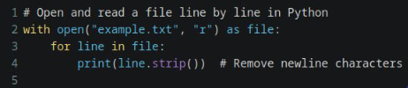

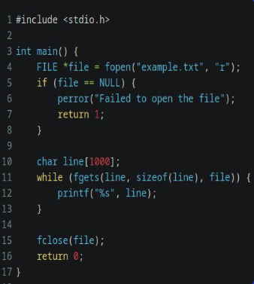
Example [1]
Resource management
Conclusions:
With C you have much more control over I/O, memory, etc.
However this is at the cost of writing more and taking much more into consideration
With Python you do not have direct control over I/O, memory etc.
However you have a high level abstraction that takes care of the trivialities

Slide 6
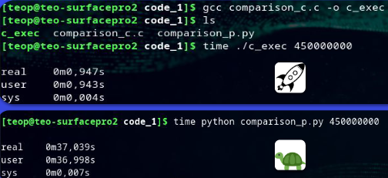
Example [2]
Computing Speed - count to 450 mln.
Conclusions:
Speed is relevant
40x slower than C
To be noted:
We are not using generators

Slide 7
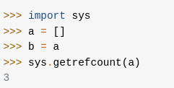
Global Interpreter Lock [GIL]
Race condition Problem => GIL was the solution
The Global Interpreter Lock (GIL) in Python is:
a mechanism designed to protect access to Python objects, preventing multiple native threads from executing Python bytecodes simultaneously in a single process.
The presence of the GIL has significant implications for Python's concurrency model, particularly in multi-threaded environments.
Python uses reference counting for memory management.
This means that objects created in Python have a reference count variable that keeps track of the number of references that point to the object.
When this count reaches zero, the memory occupied by the object is released.

Slide 8
GILs Problems
Problems:
Single Threaded Execution
Impact on CPU-bound tasks and I/O-bound tasks
Even in a multi-threaded Python program, only one thread can execute Python code at a time. As a result, Python threads cannot fully utilize multiple CPU cores for CPU-bound tasks.
CPU-bound tasks, which involve heavy computation, are particularly affected by the GIL since they cannot be parallelized effectively across multiple CPU cores within a single Python process

Slide 9
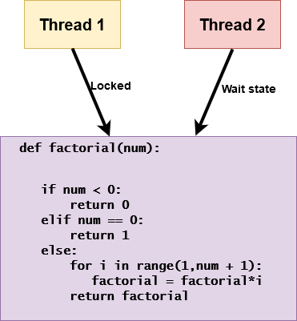
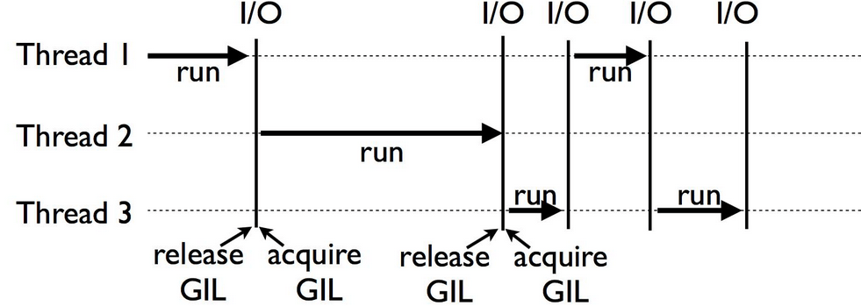
Example [1]
Calculating Factorials in the context of GIL
As you can see, there is a factorial function and two threads 1 and 2
Thread 1 is in the locked state while Thread 2 is in a wait state. - only one of the threads is able to access the function.
Assume that the factorial function takes 2 seconds to complete.
In an ideal case, both the threads should be able to finish the execution in 2 seconds. However, this is not the case in Python, both the threads will run serially and not parallel to each other.
The threads 1 and 2 calling the factorial function may take twice as much time as a single thread calling the function twice. This also tells you that the memory manager governed by the interpreter is not thread-safe, which means that multiple threads fail to access the same shared data simultaneously.
In Python 3, you have fixed-time allocated for each thread, i.e., 5ms of execution time. This prevents the threads from starving for resources since the waiting time is equal for all the threads. The threads will wait to see if the GIL gets released by Thread 1 on purpose because of I/O or sleep operation. If not, it will force it to release after 5ms. Hence, there will not be any starvation of CPU time since every thread will get an equal amount of time, and this will eliminate the challenge of acquiring the GIL.

Slide 10
If GIL is such a problem, then how to accomplish multiprocessing / multithreading ?
Multiprocessing
Multiple interpreters
Parallel process on CPU core is OK
I/O is OK
Multithreading
Limited to 1 interpreter
Scheduler for threads
I/O await is OK
While the GIL limits the performance of CPU-bound multi-threaded Python applications, developers can use processes or asynchronous programming models to work around the GIL's limitations.
Python's multiprocessing module allows concurrent execution using separate processes, each with its own Python interpreter and memory space, thereby avoiding the GIL.
Additionally, asynchronous programming using libraries like asyncio or concurrent.futures enables efficient I/O-bound concurrency without relying heavily on threads.

Slide 11
Small Summary
Reading a file in C vs Python:
C: More lines, more I/O control, faster.
Python: Less code, handles I/O complexities.
For loop count speed:
C: 40x faster execution.
Python: Slower due to interpretation overhead.
GIL (Global Interpreter Lock):
Restricts execution of multiple threads simultaneously.
Guarantees safety, limits Python's multithreading efficiency.

Slide 12
Syntax and Features
Context managers
Resource Management
Automatic cleanup
Readability
Reduce boilerplate
Consistency
Decorators
Good SoC
High flexibility
Dynamic behavior

Slide 13
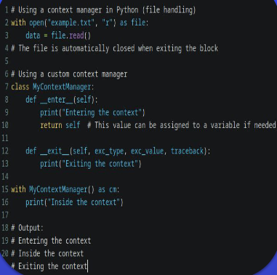
Context Manager
Resource Management
Automatic cleanup
Readability
Reduce boilerplate
Consistency
Context managers are a powerful feature in Python for resource management and ensuring that resources are properly acquired and released.
In C and other languages a similar concept exists but most of the time must be implemented manually. You have to remember to close the file explicitly to release the associated resources, and proper error handling is crucial.

Slide 14
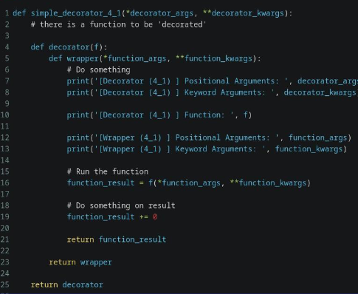
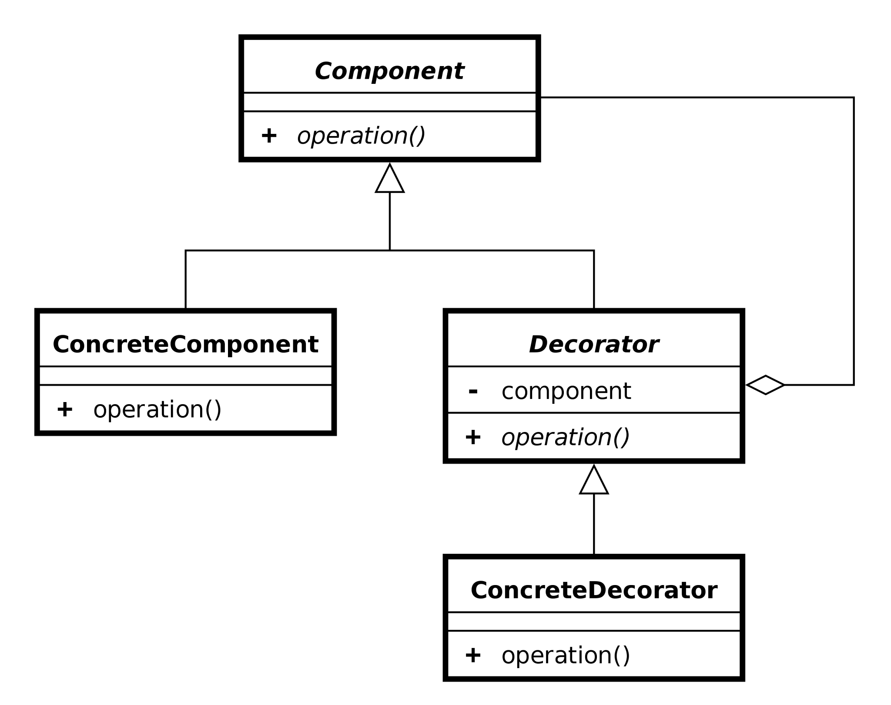
Decorator
Enhancing the modularity and reusability of code. They allow you to add functionality to existing functions or methods without modifying their actual implementation.
Encapsulate cross-cutting concerns such as logging, authentication, caching, and performance monitoring separately from the main code logic.
Good SoC
High flexibility
Dynamic behavior

Slide 15
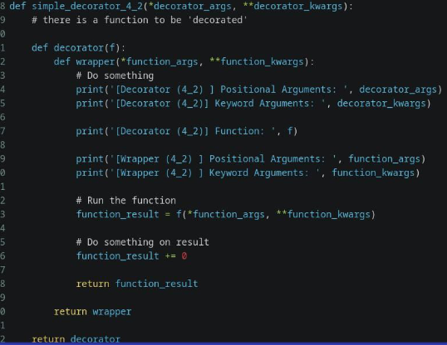
Example of Decorators

Slide 16
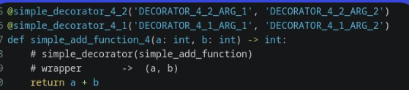
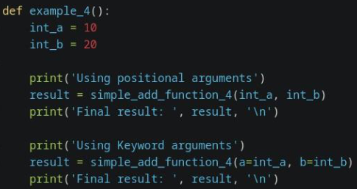

Slide 17
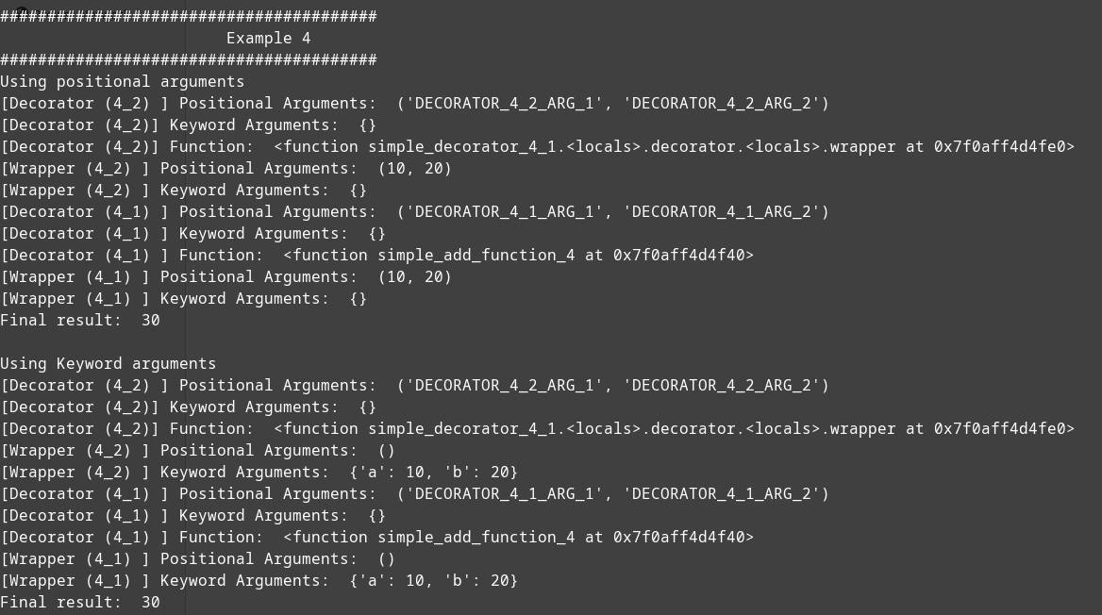

Slide 18
Small Summary
Context Managers manage resources within defined contexts. (Manage resource allocation, ensure proper cleanup.)
Decorators modify functions or methods behavior. (Enhance function behavior, promote code reusability.)

Slide 19
Object-oriented Programming [OOP]
Pros
Modularity and Reusability: OOP allows for the creation of modular code, enhancing code organization and facilitating code reuse through concepts like classes and objects.
Encapsulation and Abstraction: OOP promotes encapsulation, enabling data hiding and abstraction, which enhances code maintainability and reduces complexity.
Cons
Multiple Inheritance Complexity: While Python supports multiple inheritance, it can lead to complexities and ambiguity, known as the "diamond problem," where conflicting methods or attributes arise from multiple parent classes.
Overhead: OOP can introduce overhead in terms of memory and performance compared to procedural programming, particularly for smaller-scale projects or those not requiring the complexity of OOP paradigms.

Slide 20
Abstract classes and Interfaces
Python does not have built-in support for interfaces like some other statically typed languages (e.g., Java or C#).
Instead, Python relies on duck typing, which means that objects are evaluated based on their behavior rather than their type.
However, you can achieve interface-like behavior using abstract base classes (ABCs) from the abc module or by convention.

Slide 21
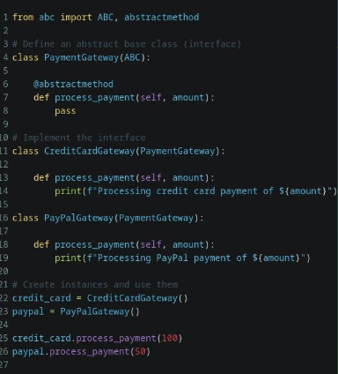
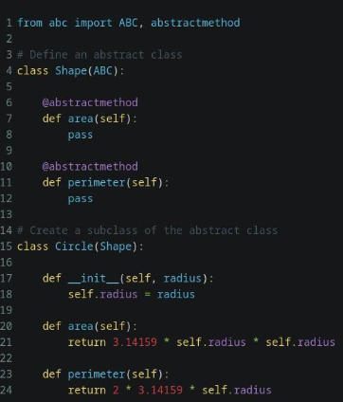
Abstract classes
Example

Slide 22
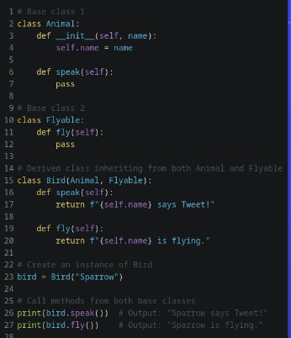
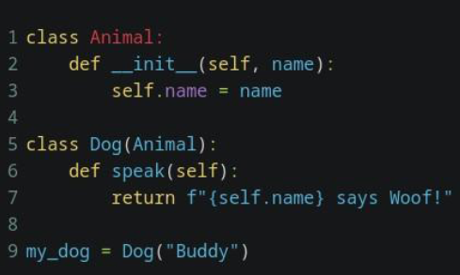
Inheritance / Multiple Inheritance

Slide 23
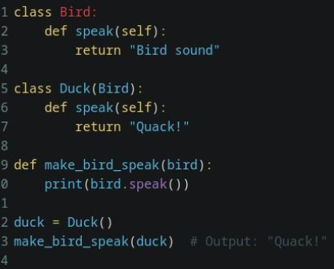
Polymorphism

Slide 24
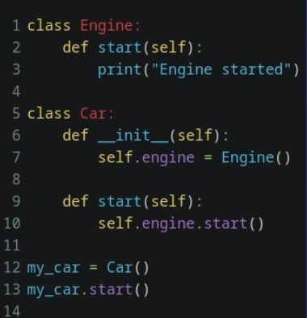
Composition

Slide 25
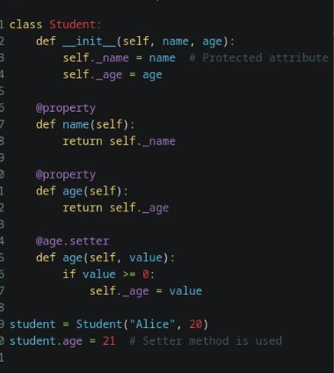
Encapsulation

Slide 26
Small Summary
Abstract classes, interfaces guide class structure. (Encourage structure, enforce method implementation.)
Inheritance shares behavior, promotes code reusability. (Facilitates code organization, reduces redundancy.)
Polymorphism allows flexible method implementations. (Enhances code flexibility, simplifies code maintenance.)
Composition builds complex objects from simpler ones. (Promotes code modularity, facilitates code reuse.)
Encapsulation hides implementation details, enhances data security. (Prevents direct access, ensures data integrity.)

Slide 27
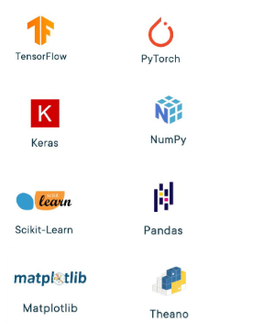
Machine Learning
Widely favored in machine learning (ML) circles for its simplicity and robust library support, this language offers a plethora of tools including scikit-learn, TensorFlow, and PyTorch.
Equipped with an array of data manipulation and visualization libraries like NumPy, pandas, and Matplotlib, it facilitates tasks such as preprocessing, data exploration, and result interpretation within ML projects.
Its user-friendly nature and clear syntax make it an optimal choice for prototyping ML models, experimenting with algorithms, and deploying solutions across diverse sectors.
Supported by a vibrant community, this language continuously evolves, providing access to the latest techniques, tutorials, and resources, catering to learners of all levels and seasoned professionals alike.

Slide 28
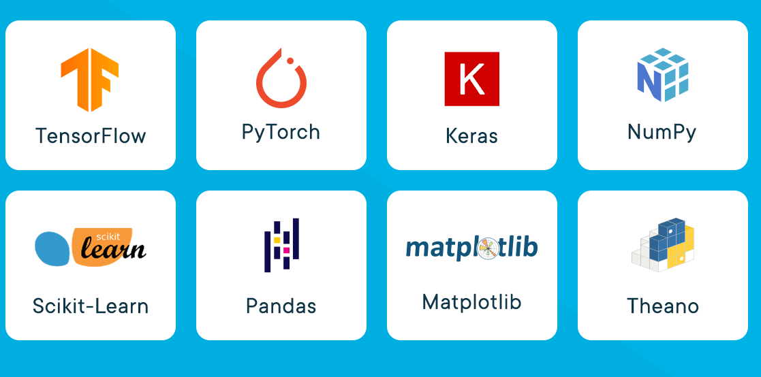
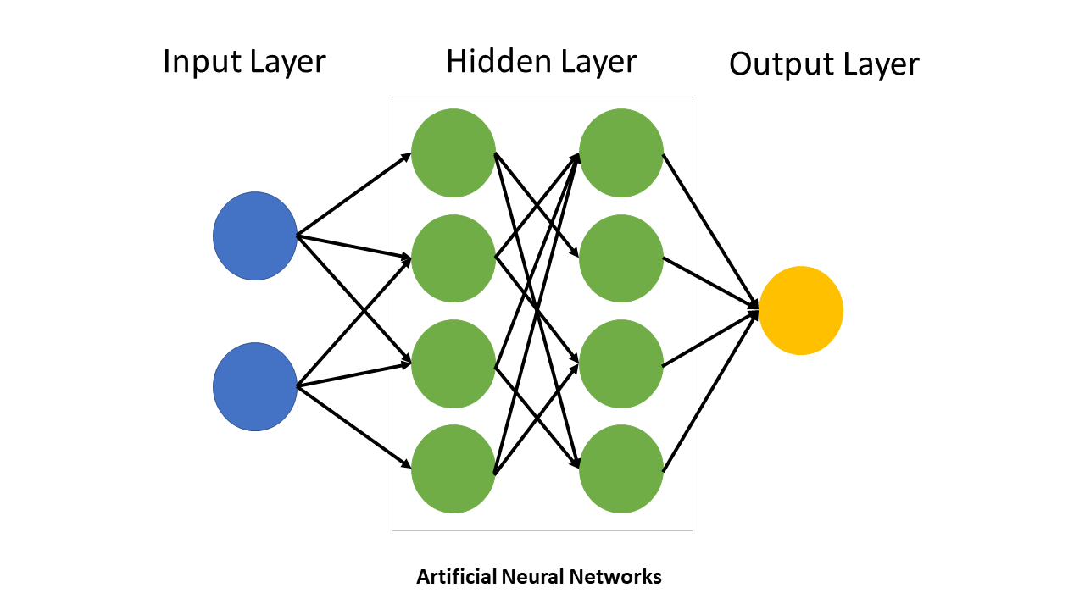
Neural Networks
Pros:
Abundant libraries (TensorFlow, PyTorch) aid development.
Python allows flexible experimentation.
CUDA
Cons:
Performance overhead due to interpretation.
Global Interpreter Lock can limit multithreading efficiency.

Slide 29
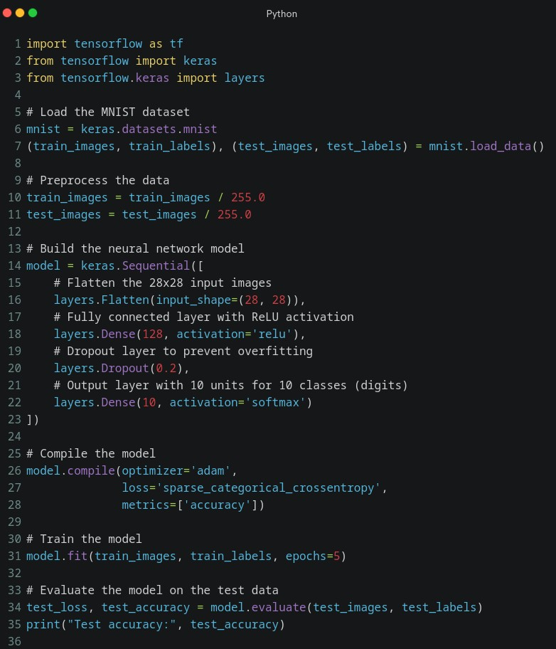
Neural Networks in Python

Slide 30
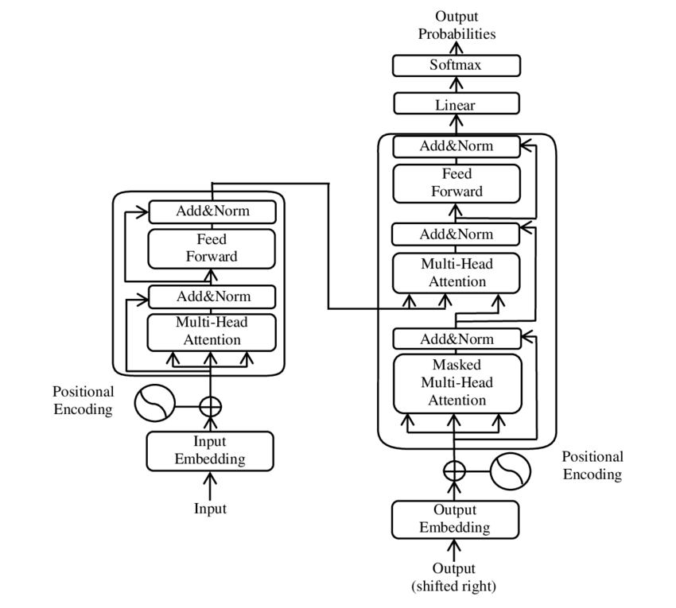
LLMs
Pros:
Implementation with Python is straightforward.
Robustness to outliers with robust regression variants.
Cons:
Vulnerability to multicollinearity.
Assumption of linearity may not hold in all cases.

Slide 31

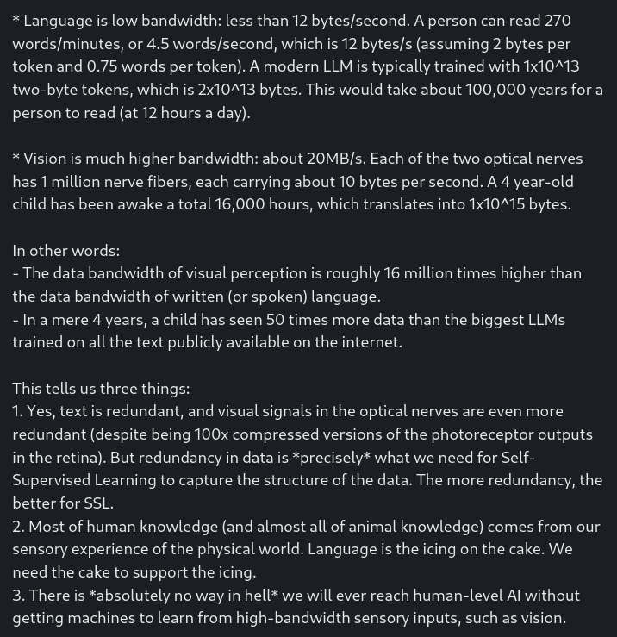
LLMs are not panacea
Yann LeCun
They are useful as writing aids.
They are "reactive" & don't plan nor reason.
They make stuff up or retrieve stuff approximately.
That can be mitigated but not fixed by human feedback.
Better systems will come.
Current LLMs should be used as writing aids, not much more.
Marrying them with tools such as search engines is highly non trivial.
Because, unlike the real world, the universe that a program manipulates (the state of the variables) is limited, discrete, deterministic, and fully observable.
The real world is none of that.

Slide 32
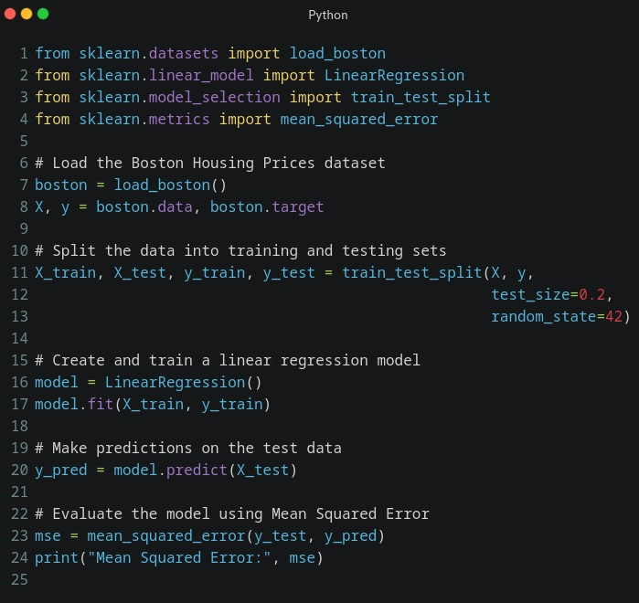
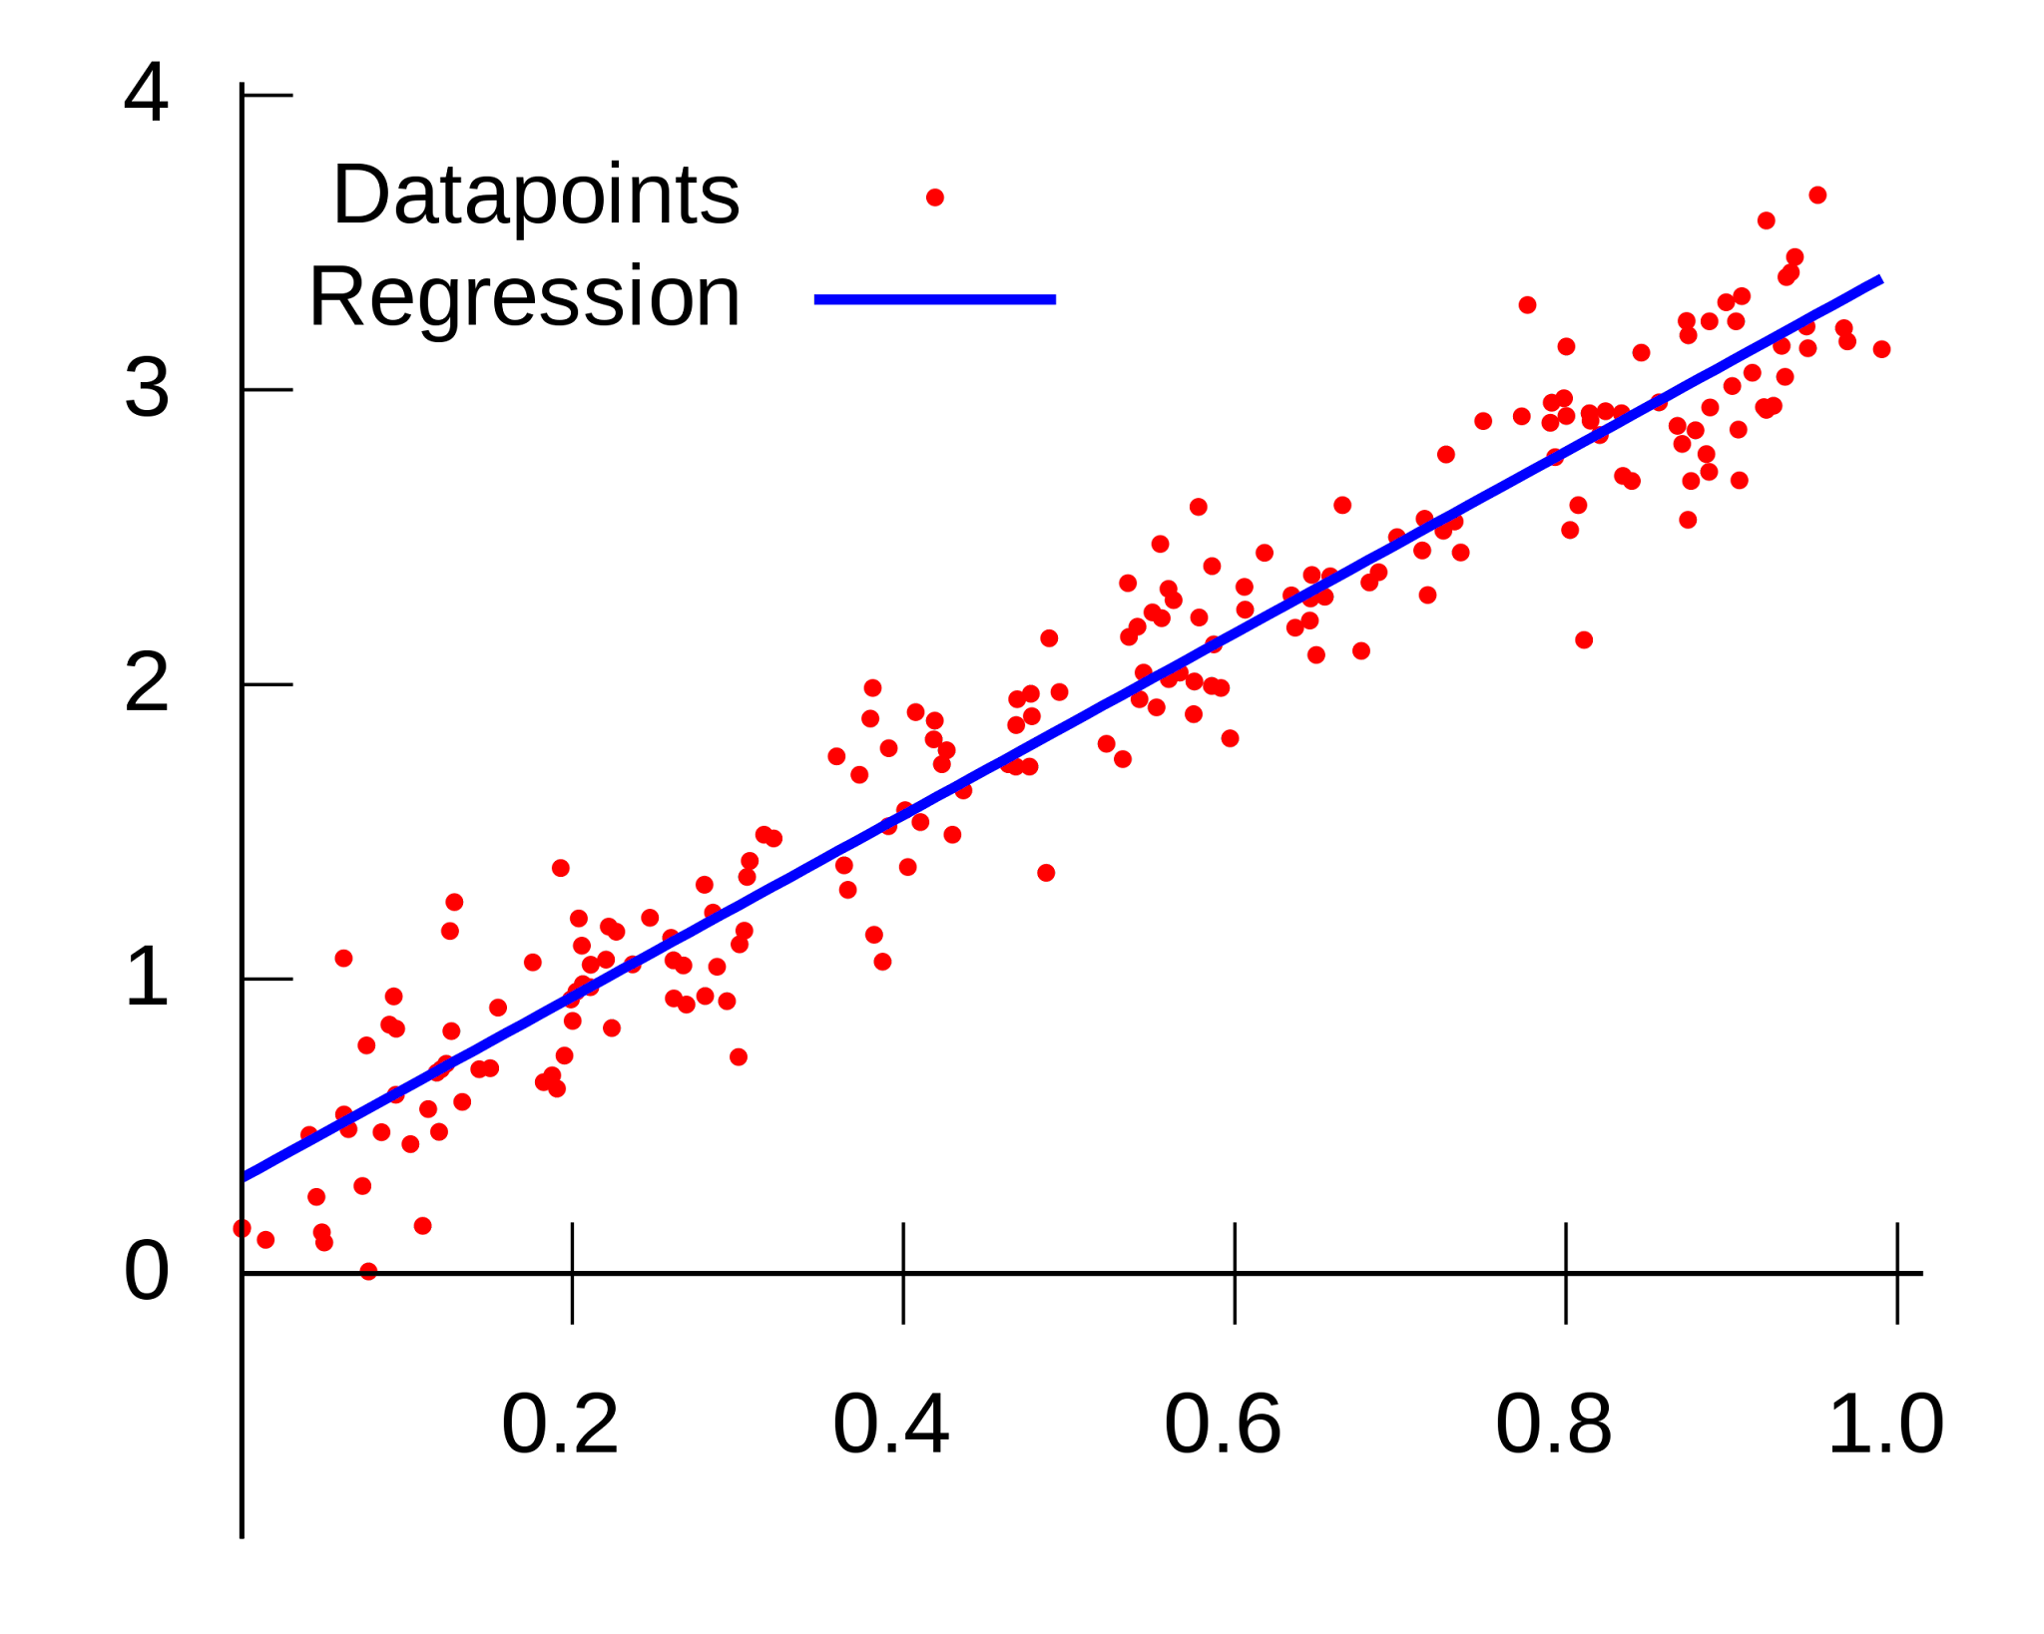
Linear Regression
Pros:
Easy implementation with libraries.
Extensive support for analysis.
Cons:
Limited complexity assumptions.
Sensitivity to outliers.

Slide 33
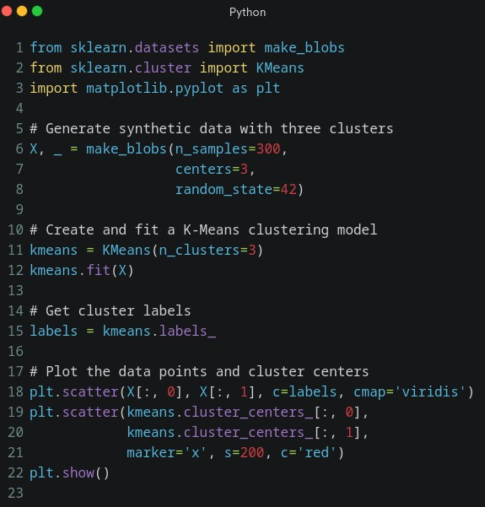
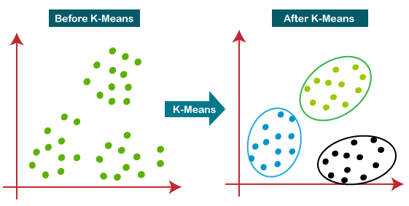
K-means Clustering
Pros:
Simple implementation with scikit-learn.
Effective for clustering in large datasets.
Cons:
Sensitive to initial cluster centroids.
Requires predefined number of clusters.

Slide 34
Exercises
Write your own Compiler for your custom Language using Python
Read “Practical Statistics for Data Scientists” by Peter Bruce, Andrew Bruce and Peter Gedeck
Create your own Neural network for solving a problem like:
Image classification - cat vs dogs
Forecasting the price of some commodity
Create a Linear Regression to forecast your monthly consumption of gas/petrol

Slide 35
Thank you

Slide 36
Resources
https://www.researchgate.net/publication/351579607_Engineering_Origami_A_Comprehensive_Review_of_Recent_Applications_Design_Methods_and_Tools
https://docs.python.org/3/
https://keras.io/
https://www.amazon.com/Design-Patterns-Object-Oriented-Addison-Wesley-Professional-ebook/dp/B000SEIBB8
https://www.amazon.com/Clean-Code-Handbook-Software-Craftsmanship/dp/0132350882

